Slide 1
An argument for the Use of digital slr cameras for amateur astro-photographers, with a collection of images
Samantha Steelman
Dec 1, 2016

Slide 2
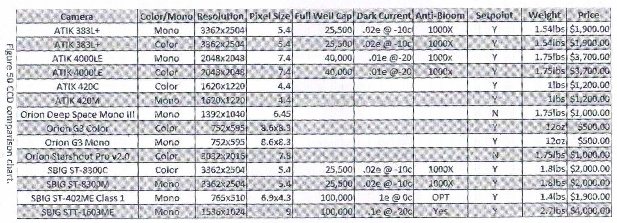
CCDs are the more appropriate tool for scientific work and imaging of very faint/distant objects, but cost more in time and money.
Table 1. Copied from Allan, H. (2013). Getting Started: Long Exposure Astrophotography (p. 75). Huntsville, Tx: Allan Hall.
Horsehead Nebula. 11.13.2016, CCD, 20” tele, Skyview Obs

Slide 3
DSLR cameras use an optical design with a reflex mirror that opens and closes opposite the shutter to view/capture the image
https://i.imgur.com/Pgt1Y.jpg
Lens
Reflex Mirror
Matte focusing screen
Pentaprism
Eyepiece
Focal Plane Shutter
Sensor

Slide 4
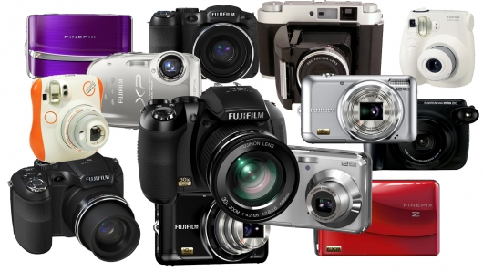
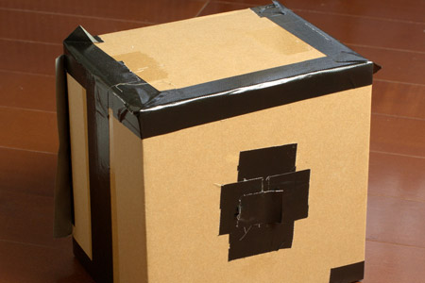
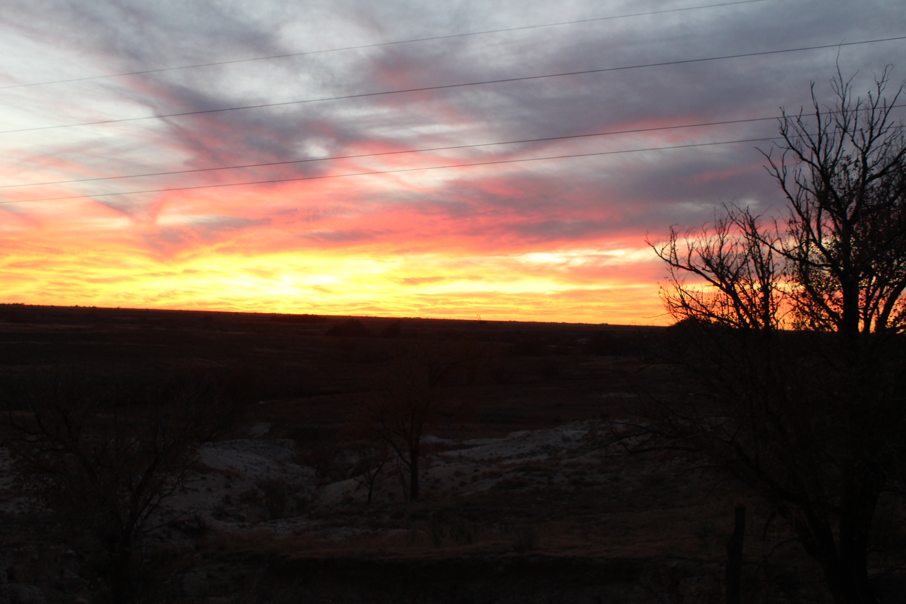
Using a camera allows more control of the user’s budget and versatility of use.
You can capture beautiful images with little more than a camera and a sturdy tripod.
http://www.diyphotography.net/files/images/3/pinhole_janne_in_osaka_0.jpg
http://images.gizmag.com/hero/fujifilm-pma-2010.jpg

Slide 5
Full Moon, 11.14.2016. Canon, 100iso, 6/125s, 75-300mm lens, Skyview

Slide 6
Full Moon Path 11.14.2016, Canon 75-300mm lens, 100iso 1/125s, Skyview Obs

Slide 7
DSLR cameras can give beginners experience in how exposure and the amount of light entering the sensor can affect an image
One can capture beautiful images with nothing but a camera and a sturdy tripod:
Full Moon Rising, 11.14.16, Canon 18-55mm lens, 100iso-3/125s, 200iso-3/125s, Skyview Obs

Slide 8
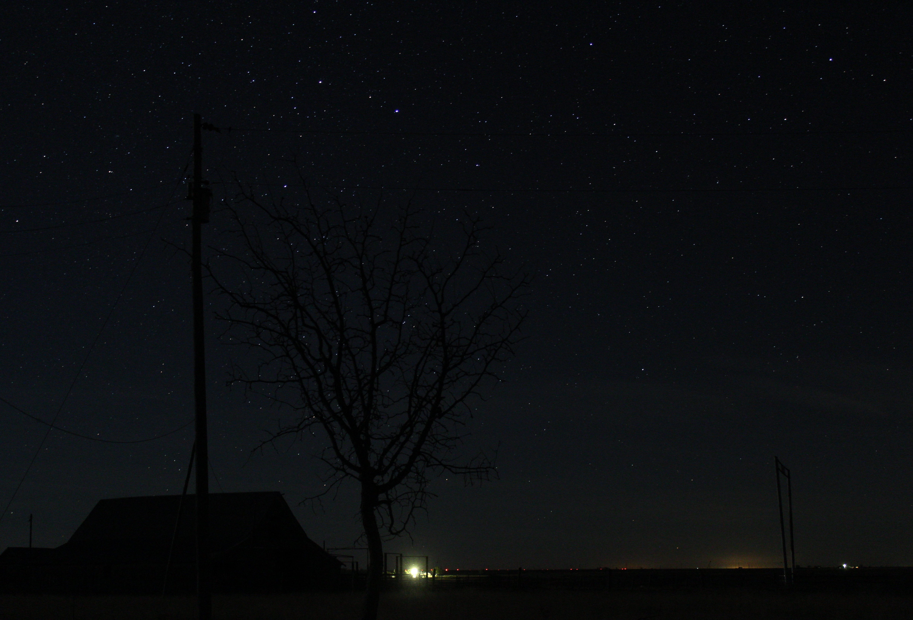
Tulia Barn 11.21.2016, Canon 18-55mm lens, 1600iso, 10s. Tulia, Tx

Slide 9
Farm House Sky 11.21.16, Canon 18-55mm lens, 1600iso, 10s. Tulia, Tx

Slide 10
Big Dipper Over Farm House 11.21.16, Canon 18-55mm lens, 800iso, 15s. Tulia, Tx

Slide 11
Northern Sky 11.21.2016, Canon 18-55mm lens, 1600iso, 30s. Tulia, Tx

Slide 12
DSLRs give amateur astronomers a cost effective opportunity to learn and grow with their craft.
Questions?
Tulia Trails 11.21.16, Canon 18-55mm lens, 100iso, 1800s. Tulia, Tx

